Slide 1
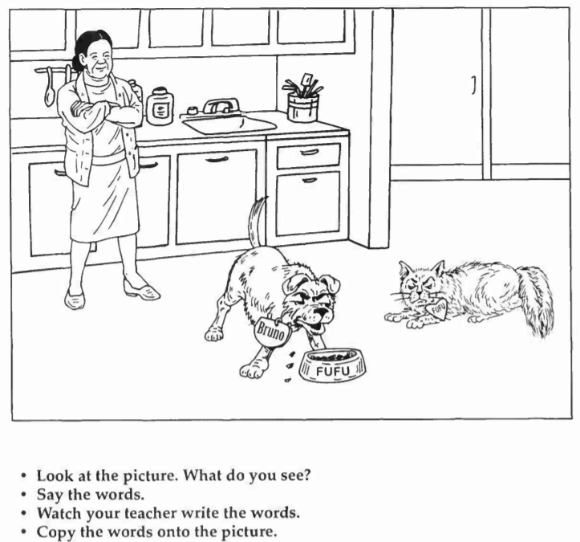
Fufu Returns

Slide 2
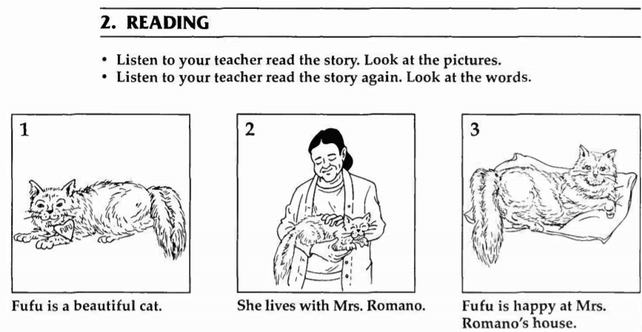

Slide 3
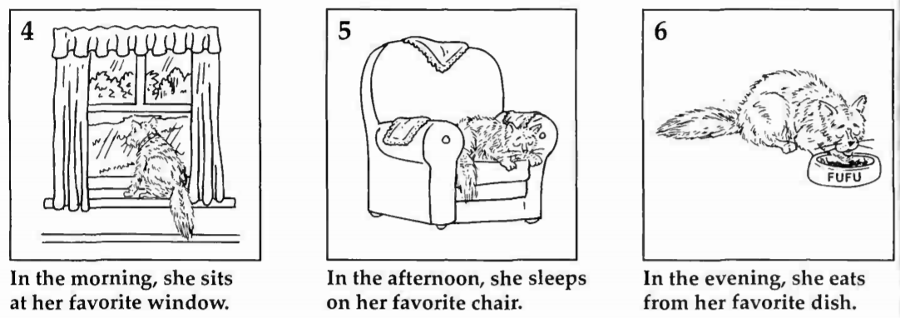

Slide 4
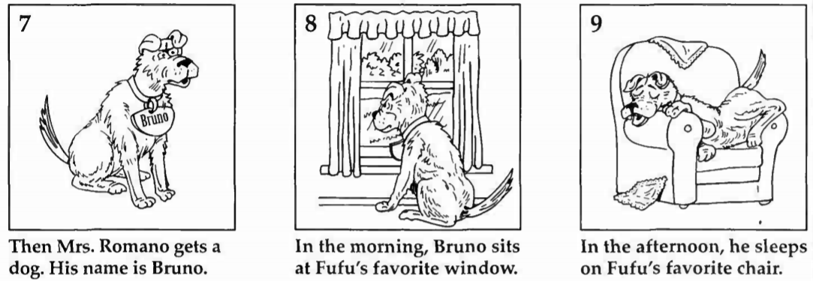

Slide 5
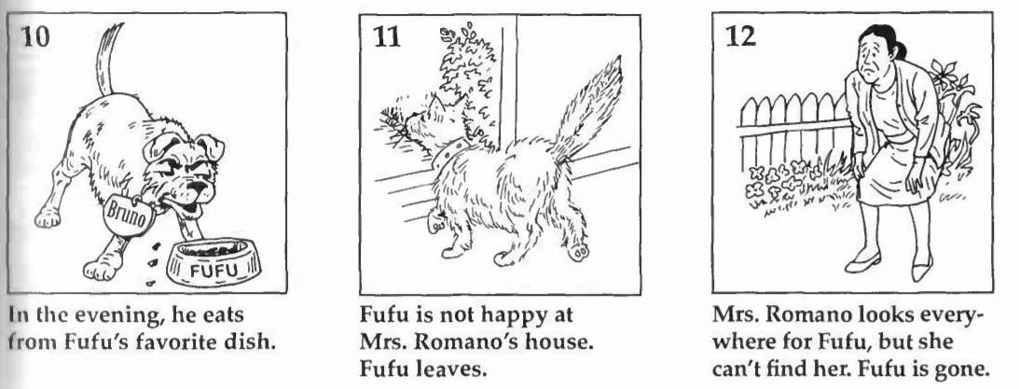

Slide 6
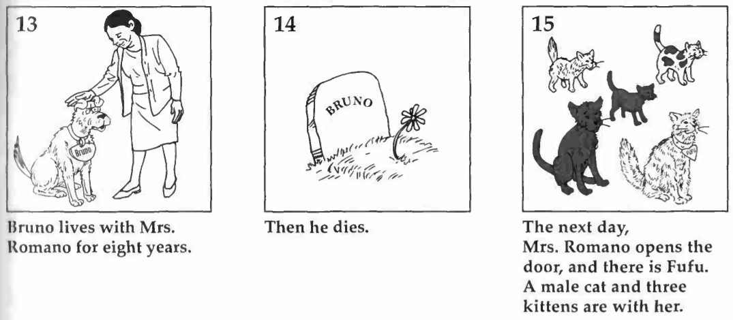

Slide 7
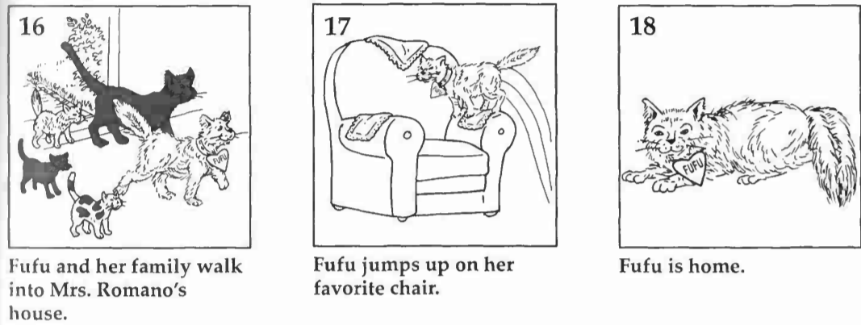

Slide 8
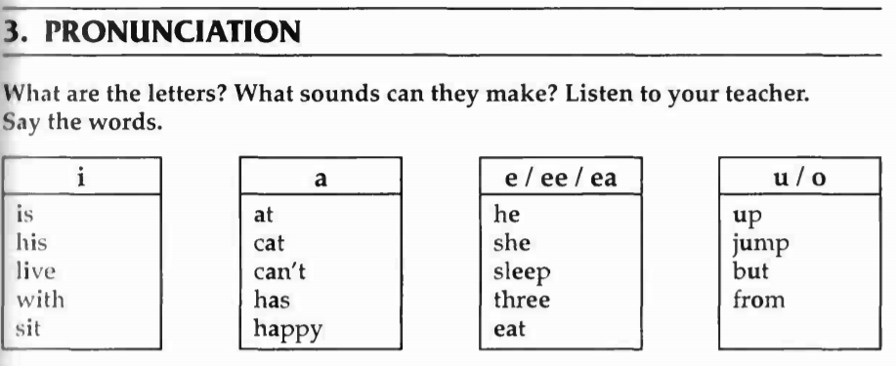

Slide 10
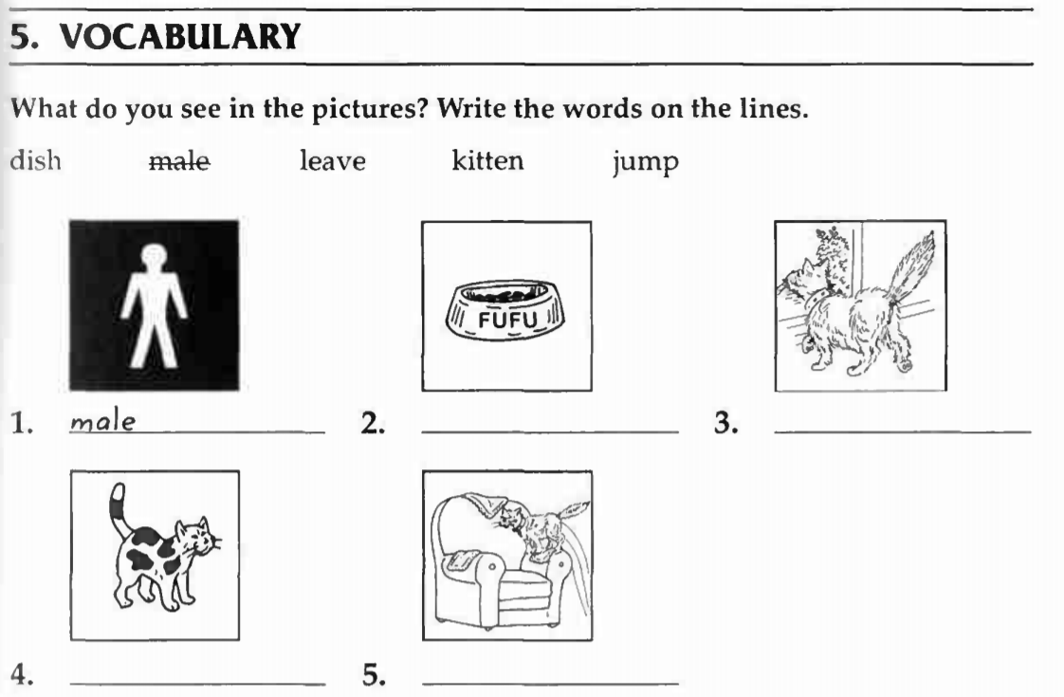

Slide 11
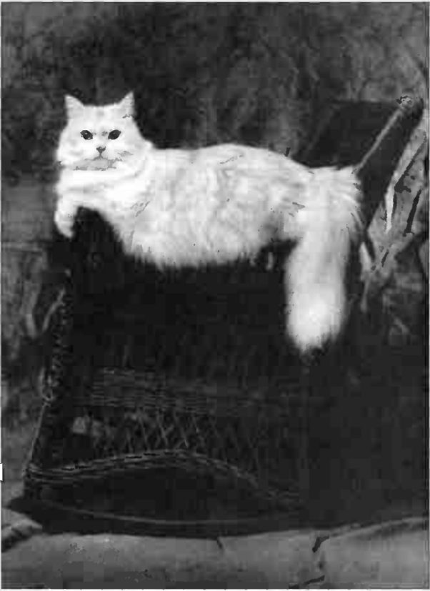
Fufu Returns

Slide 12
Fufu is a beautiful cat. She lives with Mrs. Romano. Fufu is happy at Mrs. Romano's house.
In the morning, she sits at her favorite window. In the afternoon, she sleeps on her favorite chair. In the evening, she eats from her favorite dish.
Then Mrs. Romano gets a dog. His name is Bruno. In the morning, Bruno sits at Fufu's favorite window. In the afternoon, he sleeps on Fufu's favorite chair. In the evening, he eats from Fufu's favorite dish.
Fufu is not happy at Mrs. Romano's house. Fufu leaves.

Slide 13
Mrs. Romano looks everywhere for Fufu, but she can't find her. Fufu is gone.
Bruno lives with Mrs. Romano for eight years. Then he dies.
The next day, Mrs. Romano opesn the door, and there is Fufu. A male cat and three kittens are with her. Fufu and her family walk into Mrs. Romano's house.
Fufu jumps up on her favorite chair. Fufu is home.

Slide 14
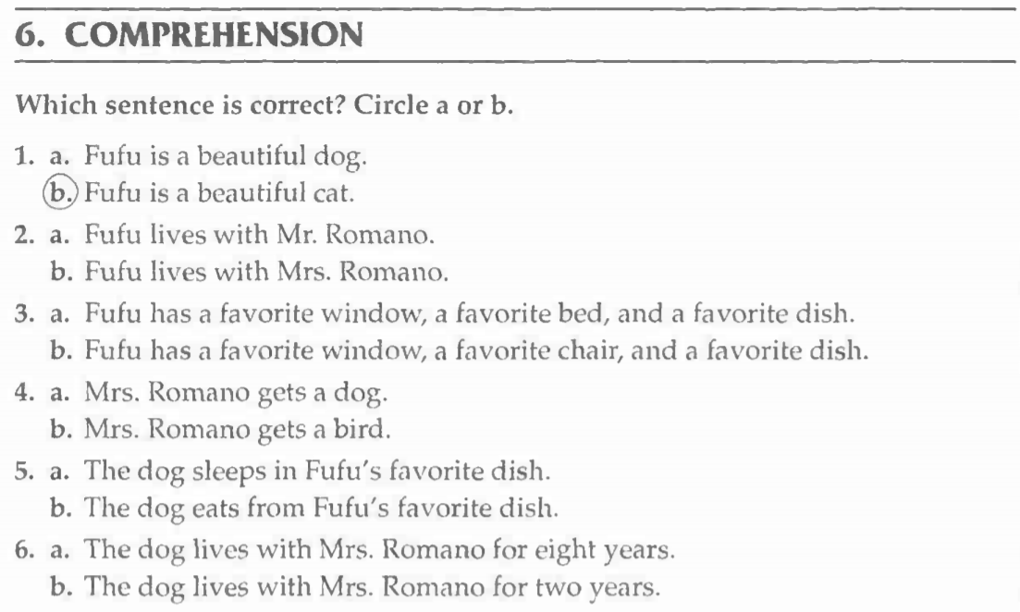

Slide 15
