Slide 1
Basic Computer Skills

Slide 2
Devices and Computer Log On

Slide 3
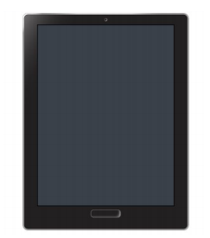
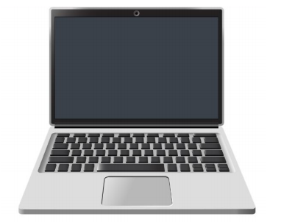
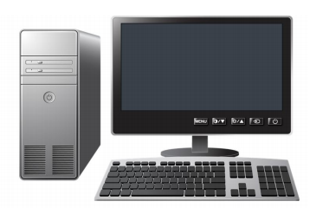
Types of Devices:
Desktop Computer
Laptop
Tablet

Slide 4
System Unit: Brain of the Computer
Usually external for Desktop computers
Internal for laptops, tablets, and smartphones

Slide 5
Monitor/Screen: Shows information from the System Unit

Slide 6
Power Button:
Most important button!
Turns on the computer or monitor

Slide 7
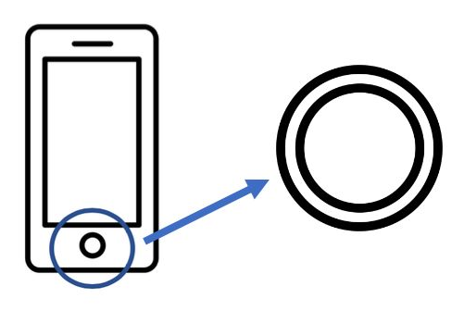
Device Buttons
Home Button:
Only found on devices like tablets or smartphones
Brings you to the home screen
Can sometimes serve as a power button

Slide 8
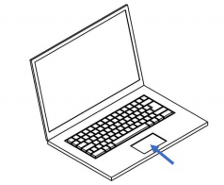
Mouse/Touchpad: Moves Cursor
Touchpad:
Mouse:
Found only on laptops
Can be used on both laptops and desktops

Slide 9
Keyboard: A place to type on the computer

Slide 10
Touch Screen:
Usually only found on tablets or smartphones
Uses touch instead of a mouse
Has a keyboard that will display on the screen

Slide 11
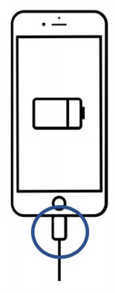
Charging Port: Place to plug in the charger
Laptops:
Smartphones and Tablets:

Slide 12
Mouse Skills

Slide 13
Mouse Shapes

Slide 14
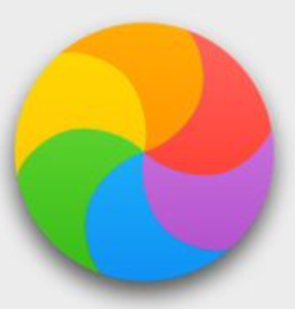
Pointer: Opens file and folders
I-beam: Shows where you can enter text
Hand: Clicks on internet links
Spinning Wheel: The computer is thinking and needs a moment to load.

Slide 15
Wifi Connection:
Connected and ready to go!
Your Internet is off!
Not connected!

Slide 16
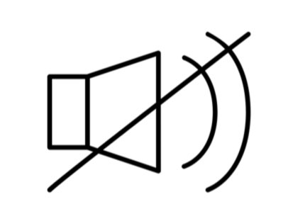
Volume Control:

Slide 17
Fixing Typos

Slide 18
Arrow keys: Moving the cursor

Slide 19
Shift: Makes letters capital or symbols from top keys

Slide 20
Backspace: deletes characters to the left of cursor
Either an arrow pointing to the left or “delete” printed on the key

Slide 21
Spacebar: Makes a space

Slide 22
Enter/Return: Makes a new line

Slide 23
Keyboard Keys

Slide 24
Caps Lock: Types capital letters

Slide 25
Tab: Creates indent

Slide 26
Copying Text:
Highlight the text you want to copy
Press Control (Ctrl) (or Command) and C
Release keys
Your text is copied! Now you can paste it!

Slide 27
Pasting Text:
Select with your mouse where you want to paste your copied text
Press Control (Ctrl) (or Command) and V
Release keys
Your text should now be pasted!

Slide 28
Drives and File Movement

Slide 29
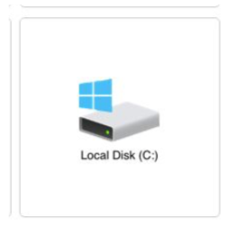
Hard Drives:
Place to store information or files that you want to save directly on the computer.
Saving a file on the desktop is one way to save on the hard drive.
You can recover files from the trash/recycle bin because they are still on the hard drive (in the computer’s memory)

Slide 30
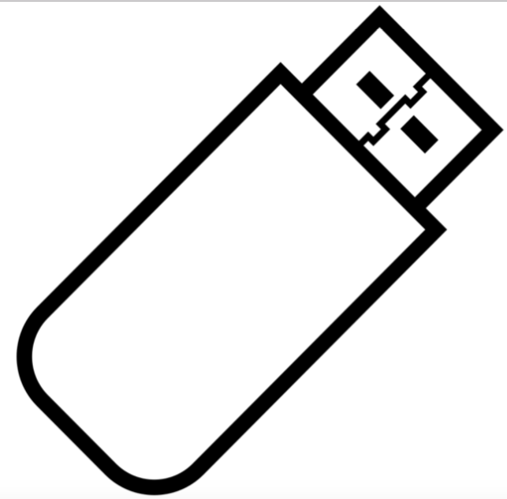
USB Drives:
A USB Drive or a Flash Drive is a portable way to save your files.

Slide 31
Cloud Drives:
A cloud drive is a place to store information on the internet.
It does not store information on your computer, instead it stores your files in a cloud that you can access from any computer (as long as you’re connected to the internet)
OneDrive
Google Drive

Slide 32
Screen Interaction

Slide 33
Customizing & Updates

Slide 34
Settings/System Preferences:
An area of the computer where you can customize the computer to be specific for your use.
Usually has a Gear-like icon

Slide 35
Updates:
Sometimes, you get a notification that you need to update your software.
Software is the operating system of your computer. It’s the set of instructions your computer follows to do different tasks.
Why and when should you update your software?
Your computer is running slowly
There are new features, something new to add to the computer’s system
New security

Slide 36
Notifications for Updates:

Slide 37
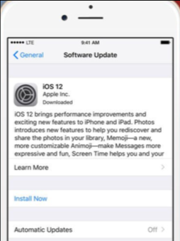
Updates on Tablets & Smartphones:

