Slide 1
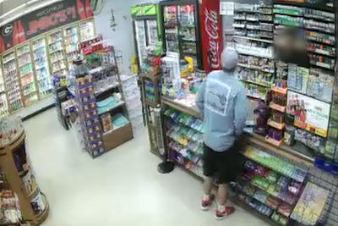
Give Me the Money
What do you see in the picture?

Slide 2
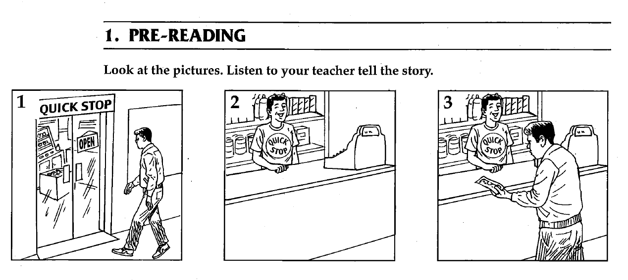

Slide 5
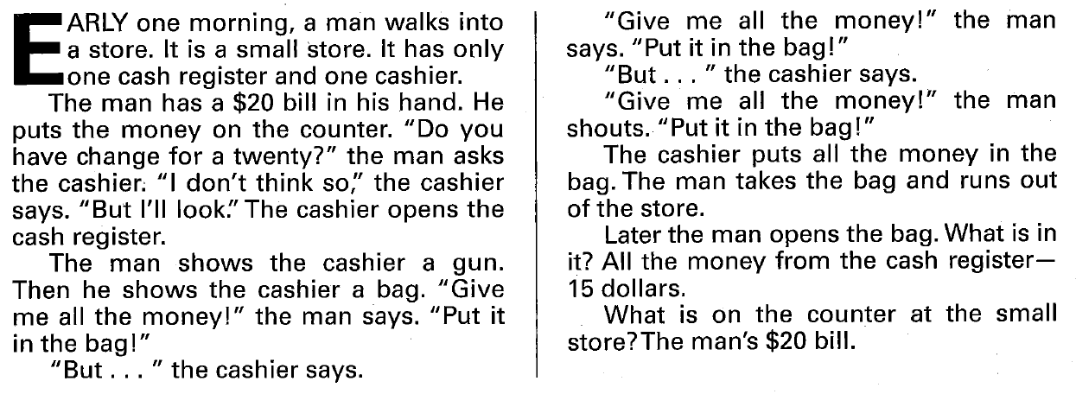
Give Me the Money

Slide 6
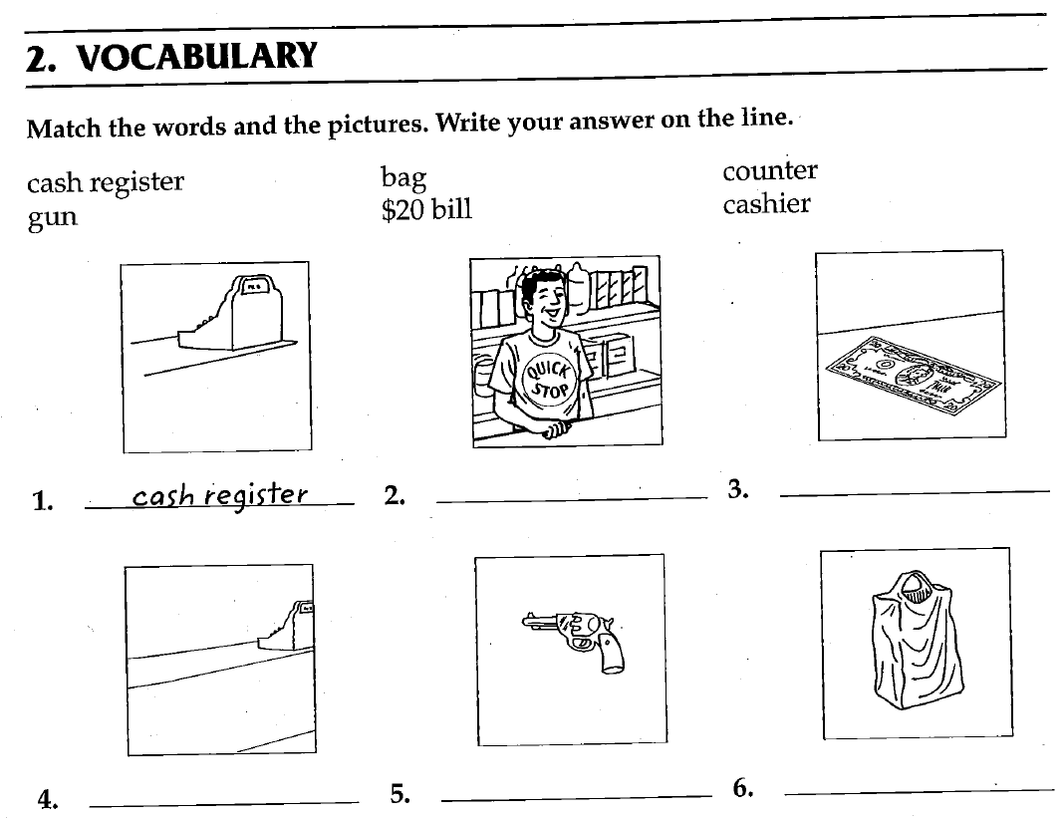

Slide 7
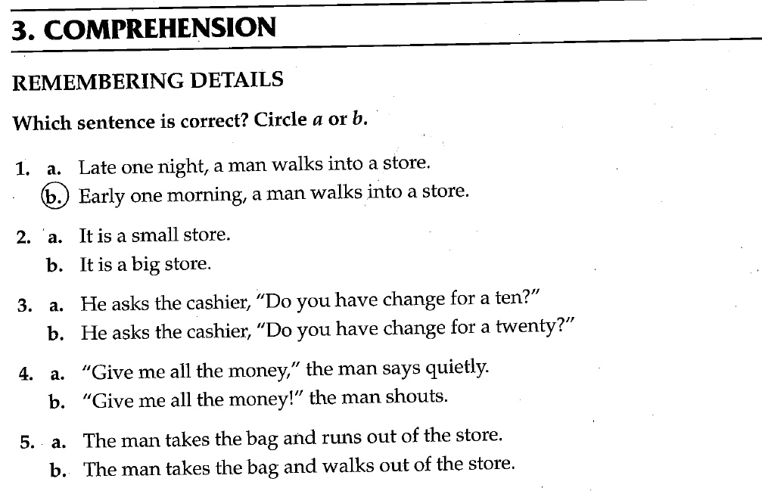

Slide 8
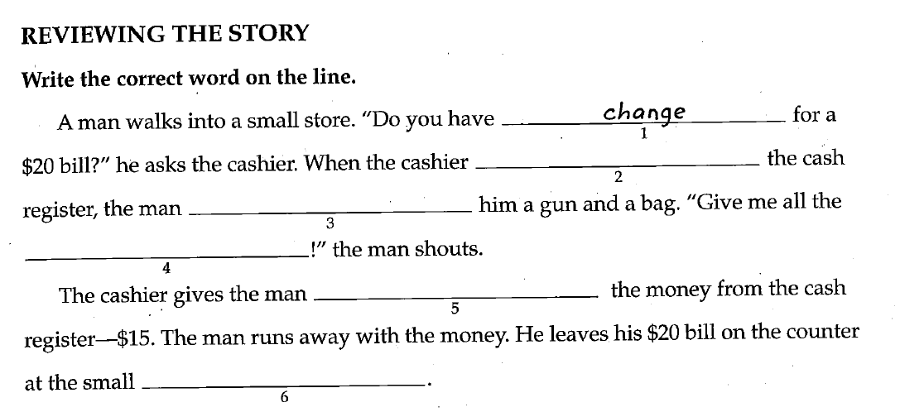

Slide 9
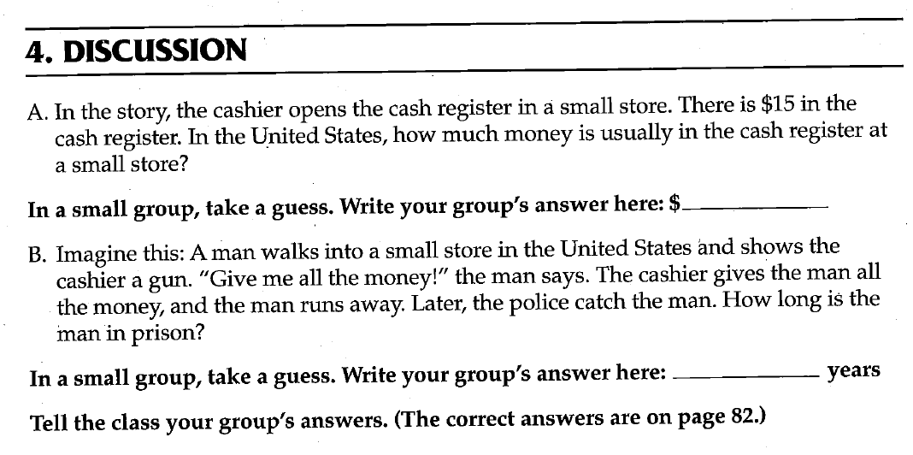

Slide 10
Dictation : Listen to the teacher read the sentences. Write down what you hear.
Walk into the store.
Put money on the counter.
Show the cashier a gun.
Run out of the store.
Open the bag.

