Slide 1
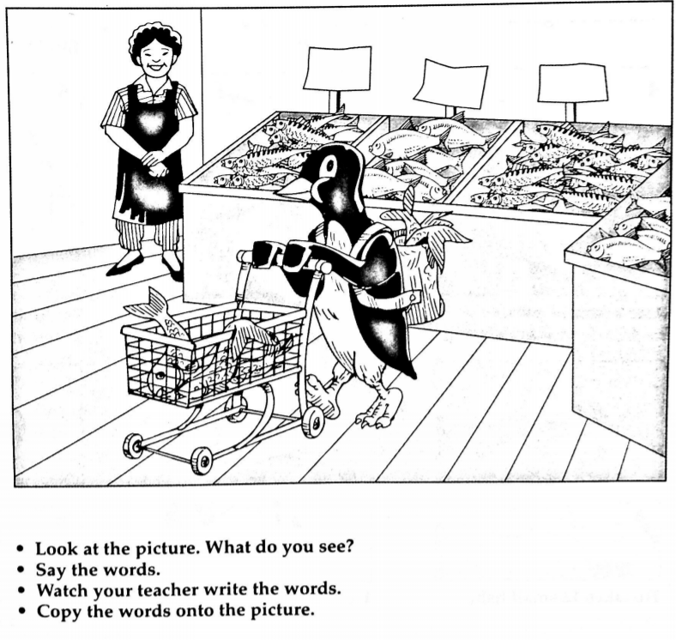
Shopping Day

Slide 2
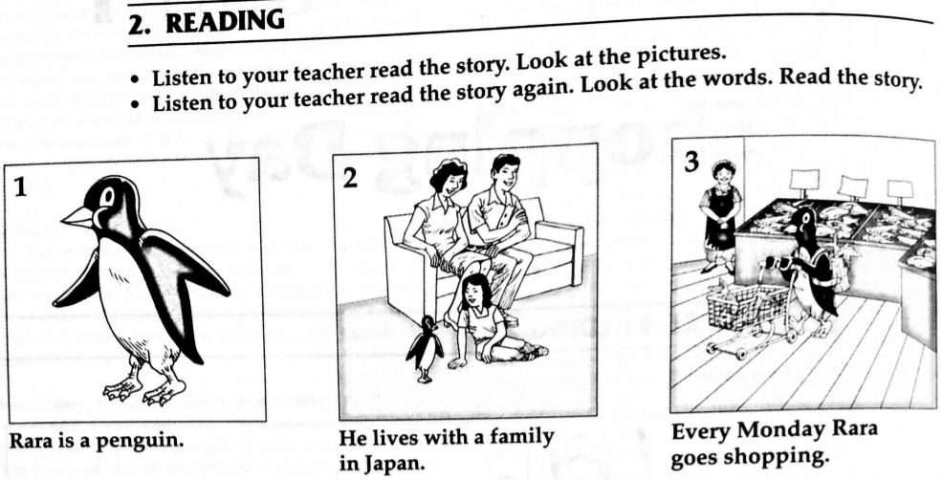

Slide 3
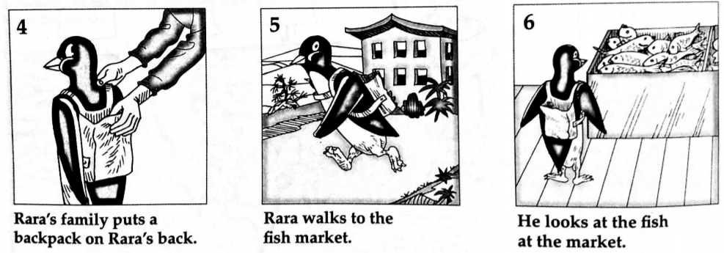

Slide 4
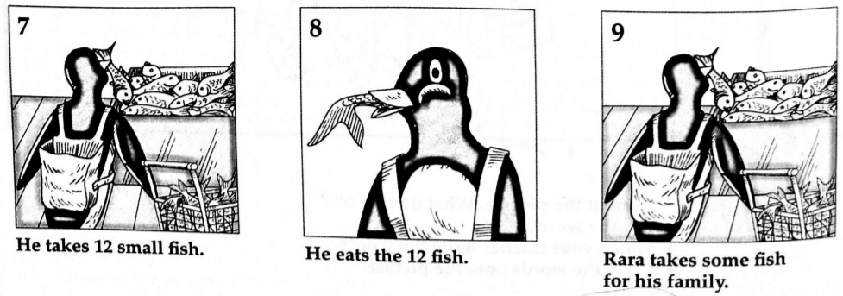

Slide 5
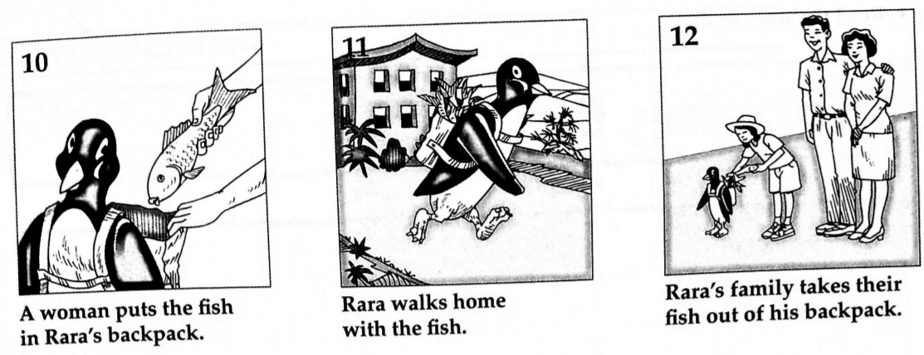

Slide 6
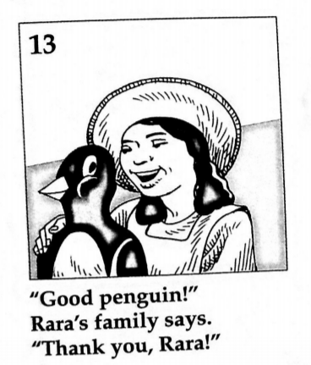

Slide 7
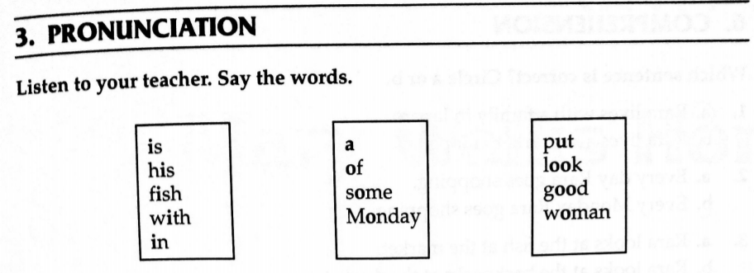

Slide 8
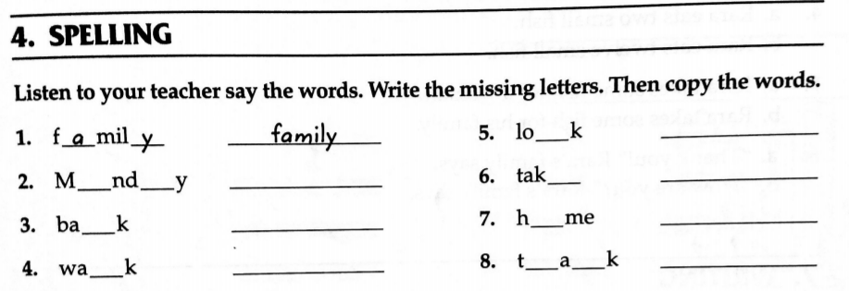

Slide 10
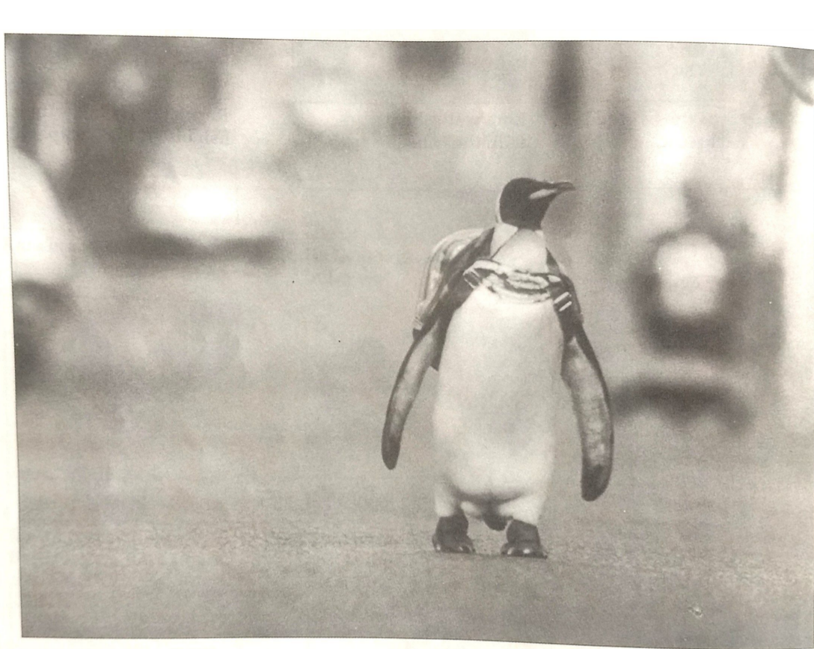
Shopping Day

Slide 11
Rara is a penguin. He lives with a family in Japan.
Every Monday Rara goes shopping. Rara's family puts a backpack on Rara's back. Rara walks to the fish market.
He looks at the fish at the market. He takes 12 small fish. He eats the 12 fish.
Rara takes some fish for his family. A woman puts the fish in Rara's backpack. Rara walks home with the fish.
Rara's family takes their fish out of his backpack.
"Good penguin!" Rara's family says. "Thank you, Rara!"

Slide 12
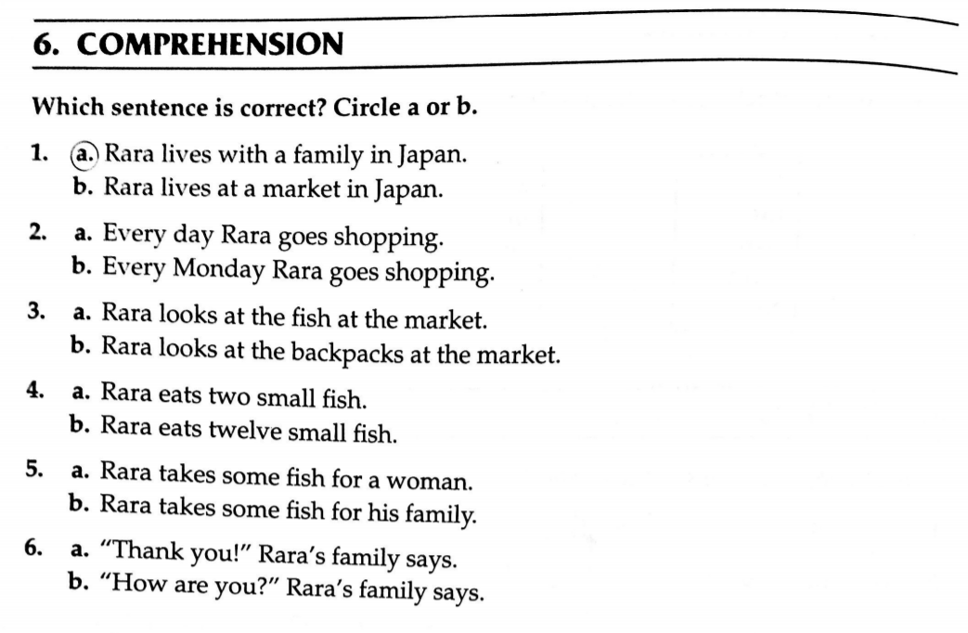

Slide 13
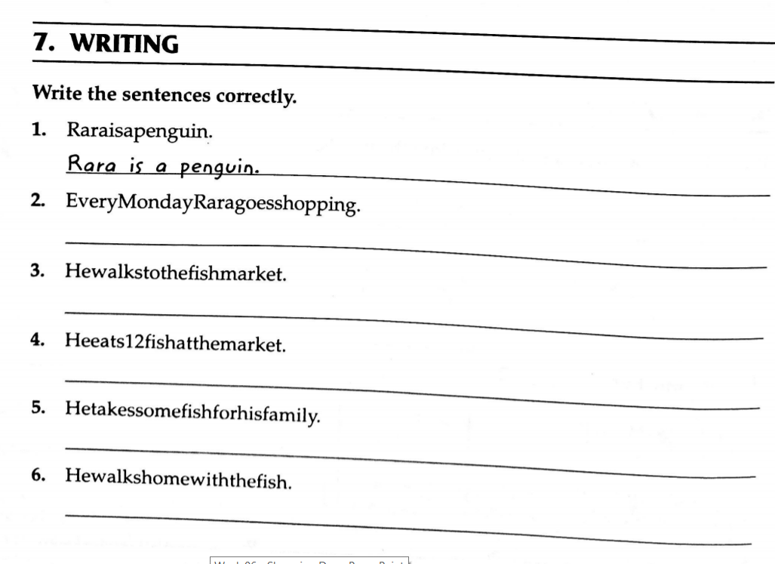

Slide 14
